Slide 1
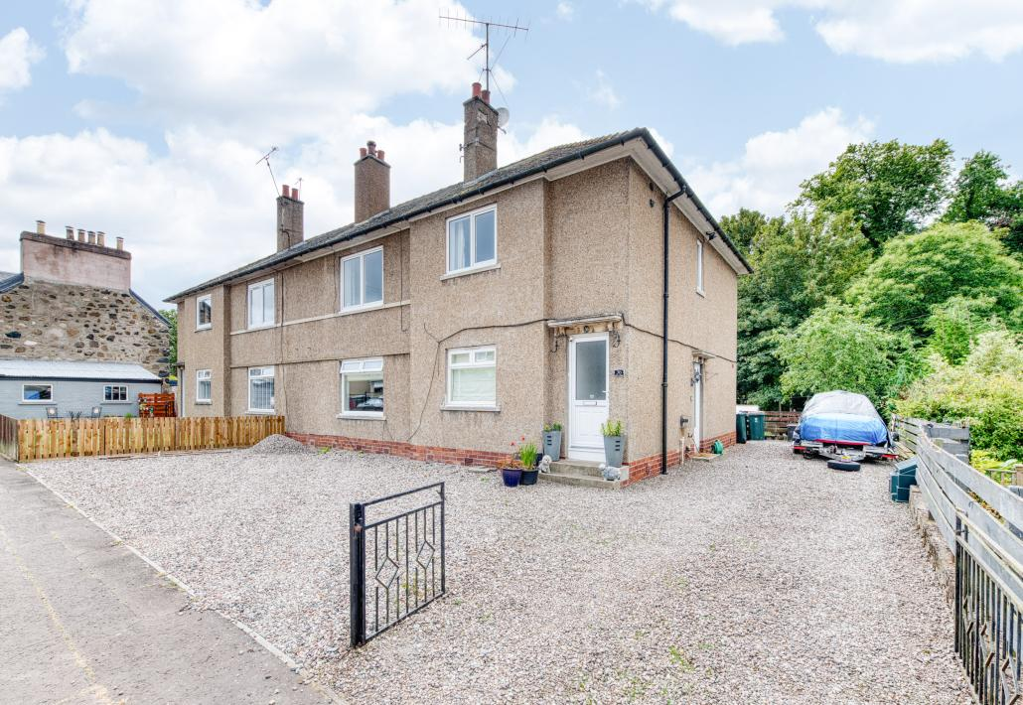

36 King Street, Stanley, Perth, PH1 4NA
Offers offer £125,000

Slide 2
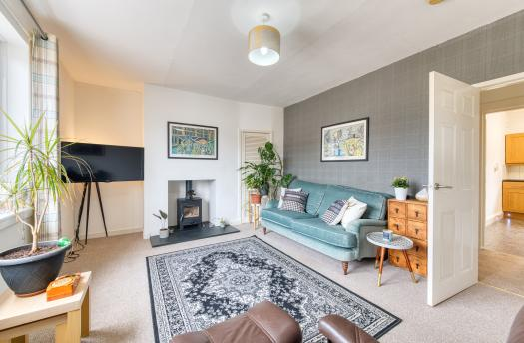
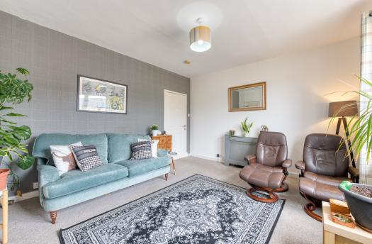

Beautifully maintained throughout, the property enjoys a bright yet cosy atmosphere, with generous proportions and an abundance of natural light creating a warm and inviting place to call home. The spacious living room provides the perfect setting for relaxing or entertaining, while the well-appointed kitchen offers ample storage and workspace, making it ideal for everyday family life.

Slide 3
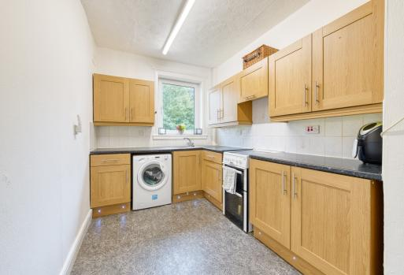
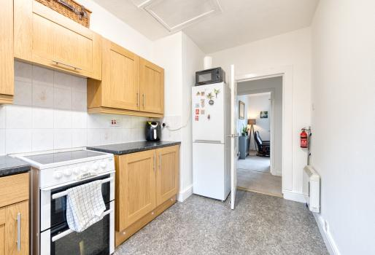
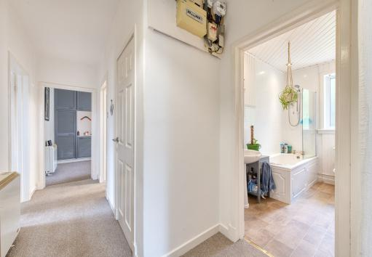
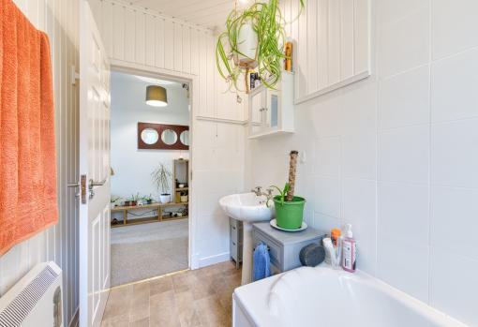

Slide 4
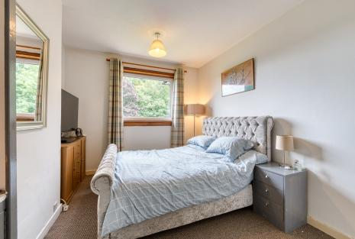
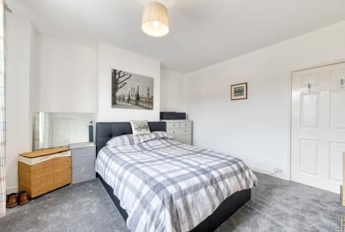
The accommodation further comprises three well-proportioned bedrooms and a modern family bathroom, with a practical layout that is perfectly suited to a variety of purchasers. Presented in move-in ready condition, the property allows a new owner to settle in and immediately enjoy everything it has to offer.

Slide 5
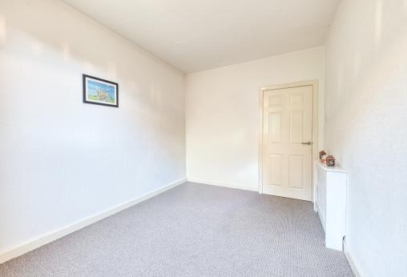
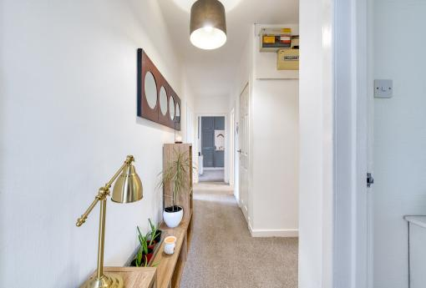
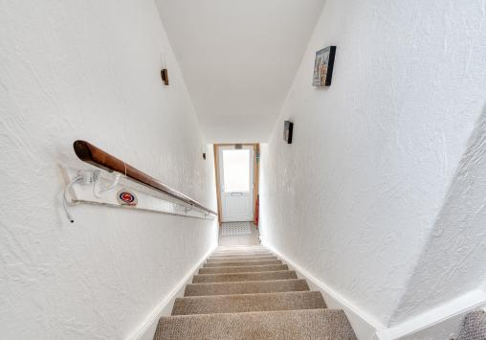
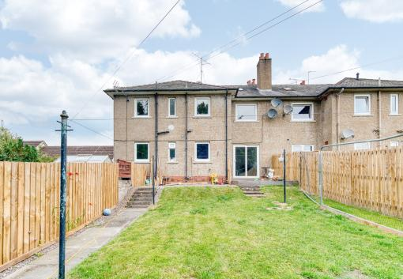

Slide 6
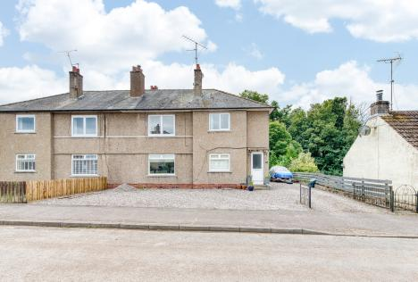
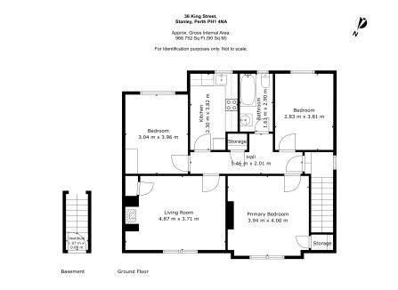
Located in the heart of Stanley, the property enjoys a peaceful village setting while remaining within easy reach of Perth, just a short drive away. Stanley offers a range of local amenities including shops, cafés, a primary school and everyday conveniences, while nearby Perth provides an extensive selection of retail, leisure and dining facilities. Excellent road links make commuting to Perth, Dundee and beyond straightforward, with the surrounding Perthshire countryside offering beautiful walks, cycling routes and outdoor pursuits right on the doorstep.
Offering spacious accommodation, fantastic outdoor space and a convenient village location, this is a wonderful opportunity to acquire a move-in ready home in a popular and well-connected community.
Get in touch
0131 644 6060
sales@monarch-legal.co.uk
monarch-legal.co.uk
Misrepresentations
The property is sold with all faults and defects, whether of condition or otherwise and neither the seller nor the selling agent, are responsible for such faults and defects, nor for any statement contained in the particulars of the property prepared by the said agent. The Purchaser(s) shall be deemed to acknowledge that he has not entered into contract in reliance on the said statements, that he has satisfied himself as to the content of each of the said statements by inspection or otherwise and that no warranty or representation has been made by the seller or the said agents in relation to or in connection with the property. Any error, omission or mis-statement in any of the said statements shall not entitle the purchaser(s) to rescind or to be discharged from this contract, nor entitle either party to compensation or damages nor in any circumstances to give either party any cause for action.

