Slide 1
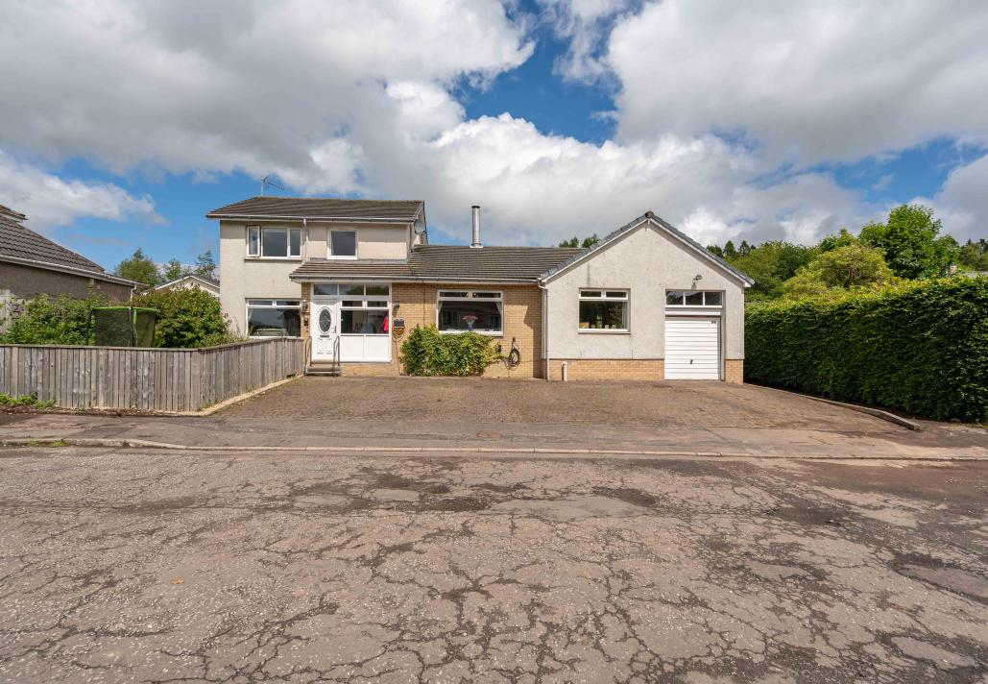

Mansewood, 43 Lagrannoch Drive, Callander, Stirling FK17 8DW
Offers offer £420,000

Slide 2
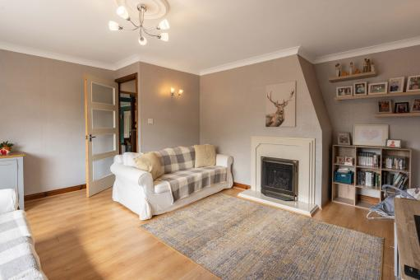
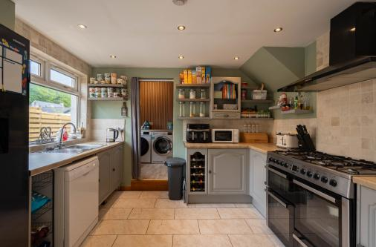

This substantial five-bedroom family home offers exceptionally generous accommodation and an inviting atmosphere, perfectly suited to modern family living.
Upon entering the property, you are welcomed by a spacious entrance vestibule that creates an impressive first impression and leads into the extensive accommodation beyond.
The property enjoys an abundance of versatile living space throughout, combining generous proportions with a warm and cosy feel that makes it ideal for both everyday family life and entertaining.
Thoughtfully designed with practicality in mind, the home also benefits from a flexible attached annex, adding further versatility and enhancing the impressive accommodation on offer.

Slide 3
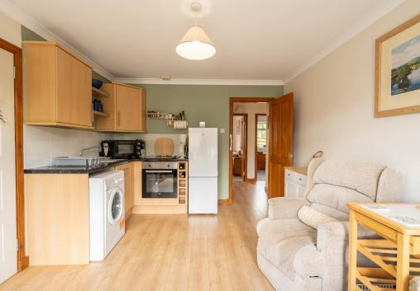
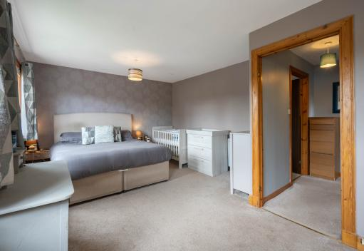
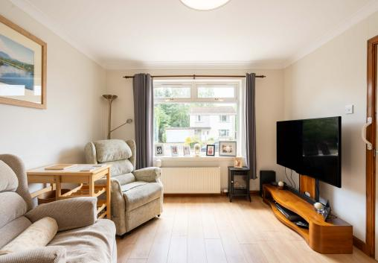
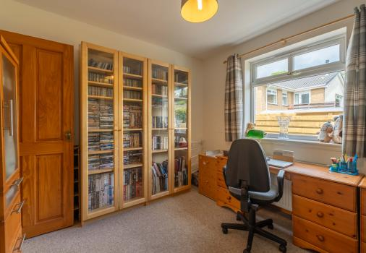

Slide 4
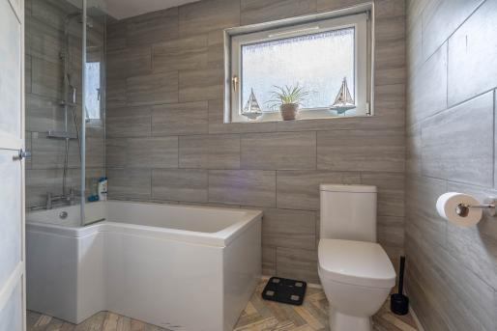
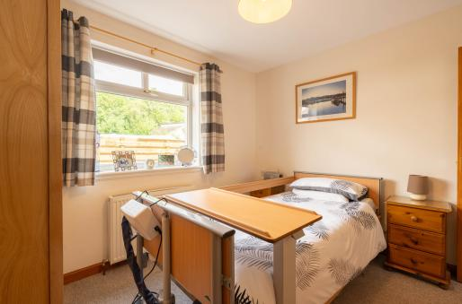
The property benefits from five well-proportioned bedrooms, offering excellent accommodation and flexibility for growing families and a variety of living arrangements, including a primary bedroom with en-suite facilities.
Further enhancing the home's appeal is the attached annex, providing additional versatile space and adding to the already impressive accommodation on offer.
Externally, the property benefits from a large private driveway, private front and rear outdoor space, and a fantastic opportunity to create a wonderful family garden and entertaining area.

Slide 5
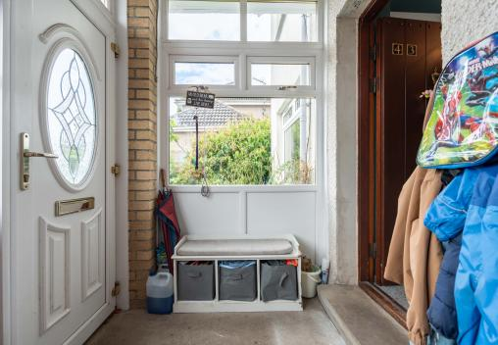
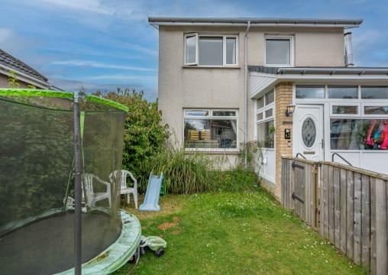
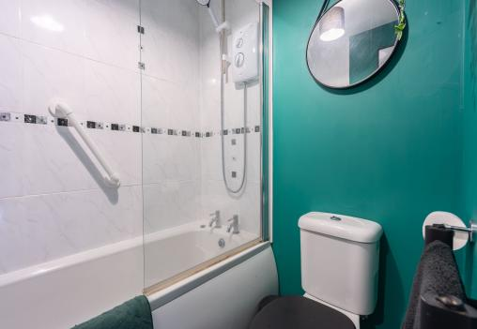
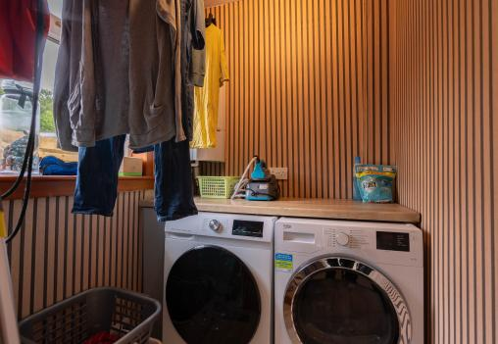

Slide 6
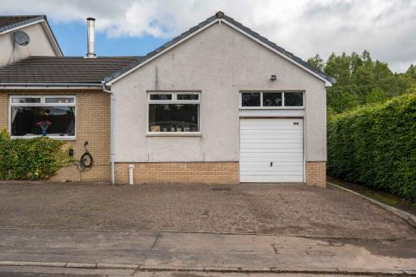
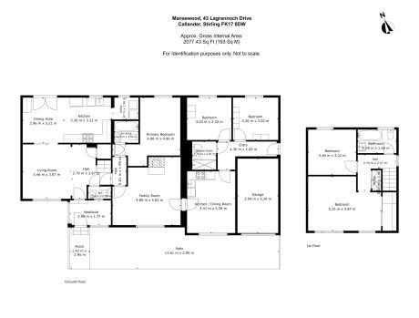
The property is situated within the picturesque town of Callander, offering a peaceful semi-rural lifestyle while still benefiting from an excellent range of local amenities. The town provides a welcoming community atmosphere with a selection of independent shops, cafés, restaurants and everyday conveniences all within easy reach.
Surrounded by beautiful scenery, Callander also offers a variety of nearby walking routes and outdoor pursuits, making it ideal for those who enjoy an active lifestyle. Well connected by road links to surrounding towns and cities, the area combines countryside living with everyday practicality, making it a highly desirable place to call home.
Get in touch
0131 644 6060
sales@monarch-legal.co.uk
monarch-legal.co.uk
Misrepresentations
The property is sold with all faults and defects, whether of condition or otherwise and neither the seller nor the selling agent, are responsible for such faults and defects, nor for any statement contained in the particulars of the property prepared by the said agent. The Purchaser(s) shall be deemed to acknowledge that he has not entered into contract in reliance on the said statements, that he has satisfied himself as to the content of each of the said statements by inspection or otherwise and that no warranty or representation has been made by the seller or the said agents in relation to or in connection with the property. Any error, omission or mis-statement in any of the said statements shall not entitle the purchaser(s) to rescind or to be discharged from this contract, nor entitle either party to compensation or damages nor in any circumstances to give either party any cause for action.

