Slide 1
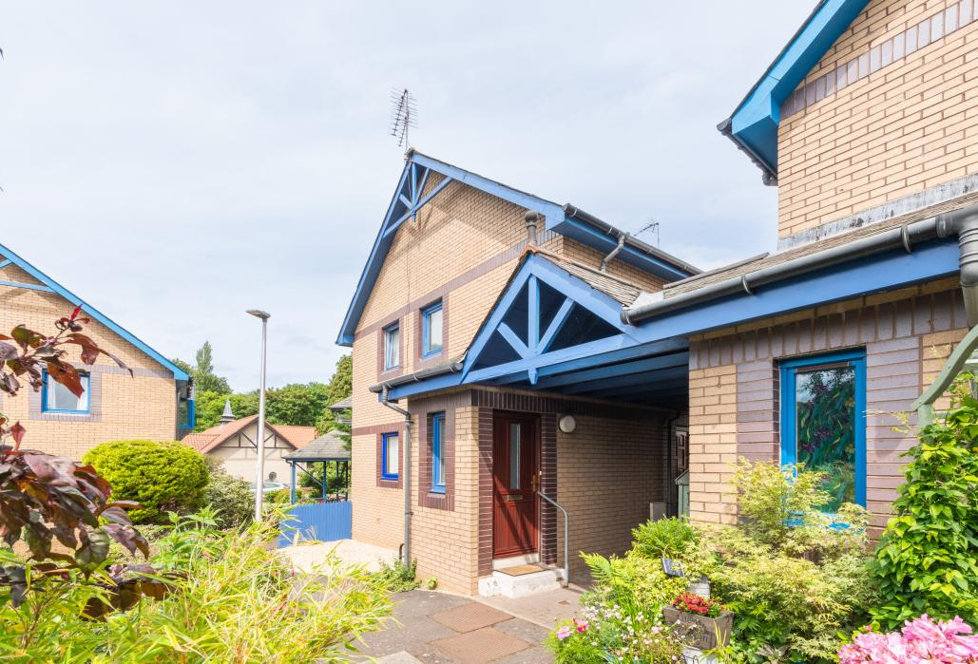

16 Eskview Grove, Dalkeith EH22 1JW
Offers over £155,000

Slide 2
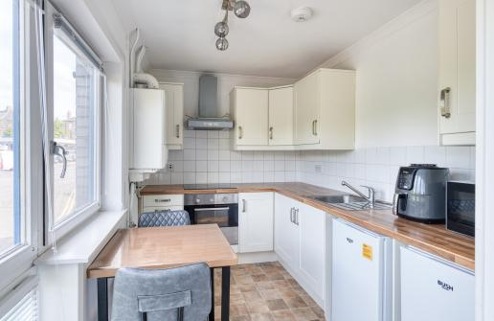
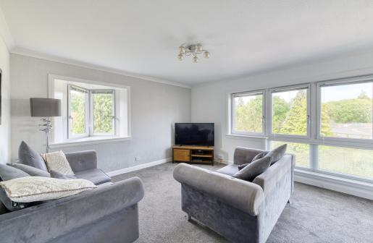

Beautifully presented throughout, this bright and spacious two-bedroom maisonette is accessed via its own private front door, creating a welcoming house-like feel.
The main living accommodation enjoys an abundance of natural light, with stylish modern interiors and a spacious layout creating a bright and airy atmosphere throughout.
Further enhancing the appeal of the property is the substantial attic level above, while externally the private garden enjoys excellent sun exposure, providing a fantastic outdoor space to relax and unwind.
.

Slide 3
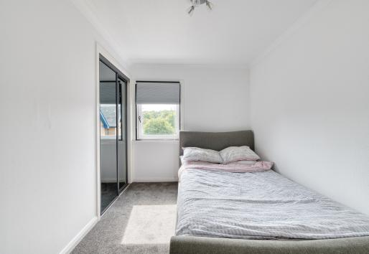
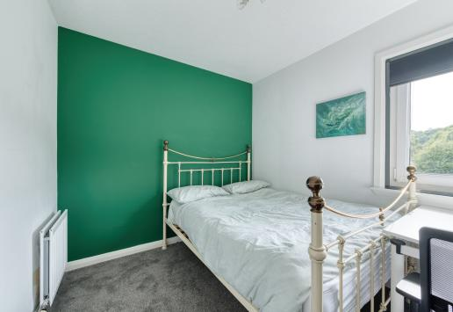
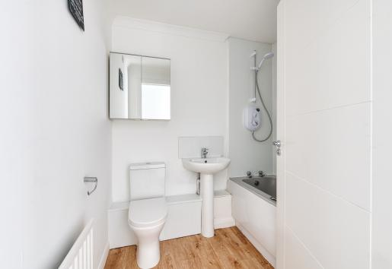
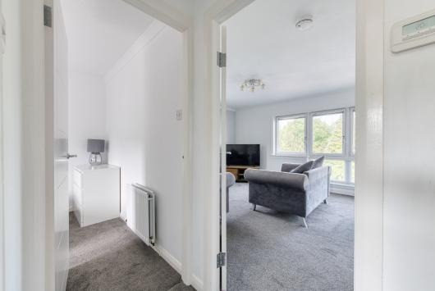

Slide 4
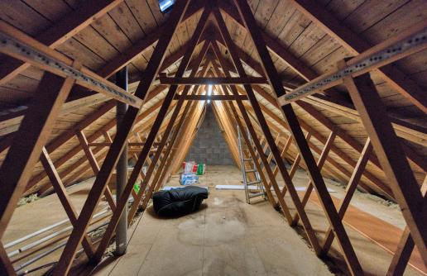
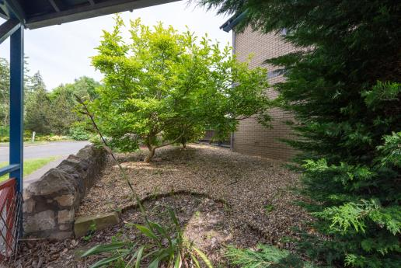
Further enhancing the appeal of the property is the substantial attic level above, providing excellent additional space and adding to the home's generous proportions and versatility.
Externally, the private garden enjoys excellent sun exposure, creating a wonderful outdoor space to relax, entertain or simply enjoy the peaceful surroundings.

Slide 5
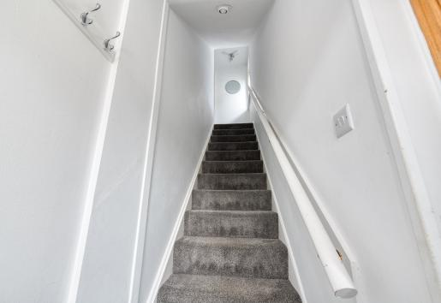
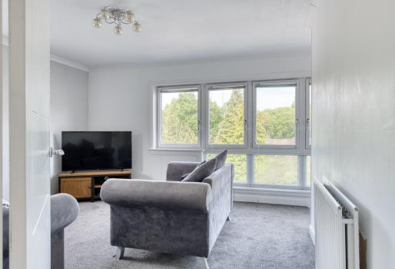
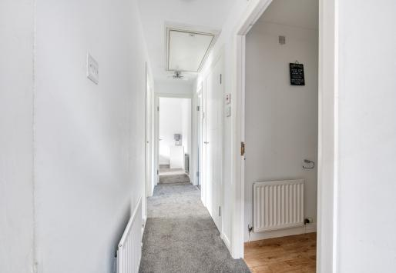
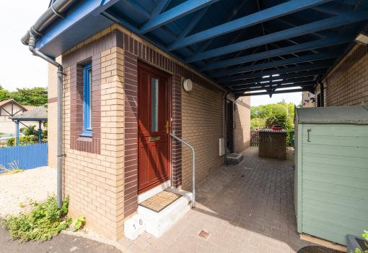

Slide 6
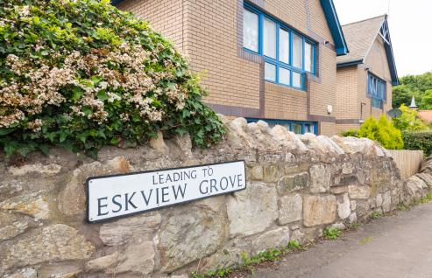
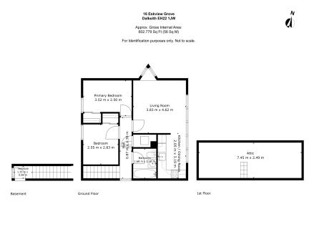
Nestled within a peaceful and leafy setting, this property enjoys an excellent location that perfectly balances tranquillity with convenience. Tucked away from the hustle and bustle, it offers a quiet residential feel while still benefiting from an abundance of amenities close at hand, creating an ideal setting for a range of buyers.
Just a short five-minute walk from the High Street, residents can enjoy a fantastic selection of local bars, restaurants, cafés and everyday amenities, making day-to-day living both easy and enjoyable. Whether meeting friends for a meal, enjoying a coffee, or accessing essential services and shopping facilities, everything is within convenient reach.
The area also benefits from excellent transport connections and easy access to surrounding areas, while nearby green spaces and local attractions further enhance the lifestyle on offer. Combining a peaceful setting with excellent convenience, this location provides the perfect balance of comfort, accessibility and community atmosphere.
Get in touch
0131 644 6060
sales@monarch-legal.co.uk
monarch-legal.co.uk
Misrepresentations
The property is sold with all faults and defects, whether of condition or otherwise and neither the seller nor the selling agent, are responsible for such faults and defects, nor for any statement contained in the particulars of the property prepared by the said agent. The Purchaser(s) shall be deemed to acknowledge that he has not entered into contract in reliance on the said statements, that he has satisfied himself as to the content of each of the said statements by inspection or otherwise and that no warranty or representation has been made by the seller or the said agents in relation to or in connection with the property. Any error, omission or mis-statement in any of the said statements shall not entitle the purchaser(s) to rescind or to be discharged from this contract, nor entitle either party to compensation or damages nor in any circumstances to give either party any cause for action.

