Slide 1
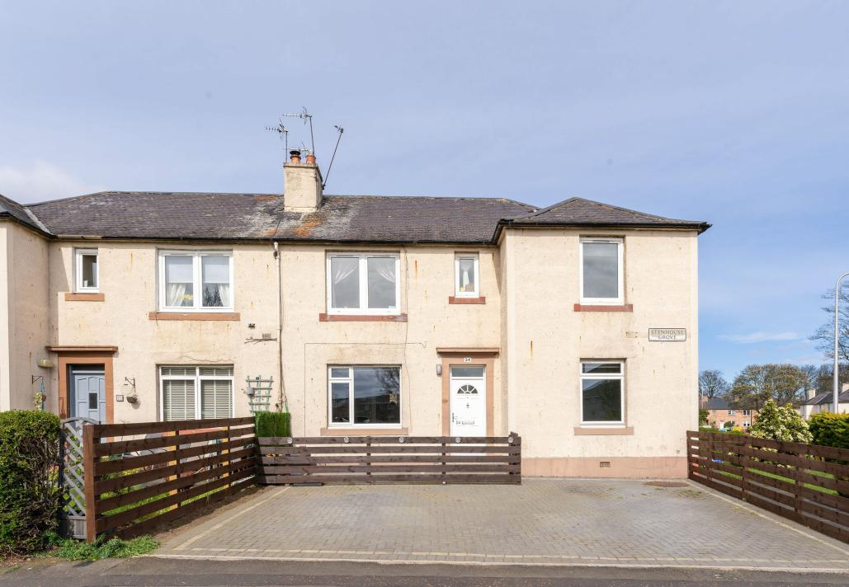
24 Stenhouse Grove,Edinburgh, EH11 3ED
Offers over £180,000

Slide 2
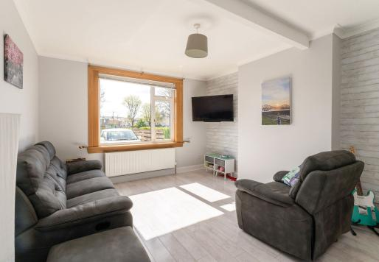
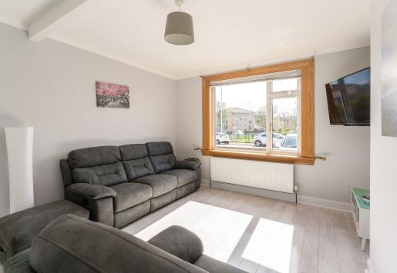
This is a well-presented ground floor two-bedroom property in the residential area of Stenhouse boasting a superb rear garden and an enviable bespoke garden room. Accessed via the generous monoblock driveway and enclosed veranda, the front door leads into an entrance vestibule and hallway with a chic monchrome interior before reaching the living room. This bright and spacious room features an expansive front-facing window, wood-inspired flooring, and an elegant grey and white décor to create a comfortable living space.

Slide 3
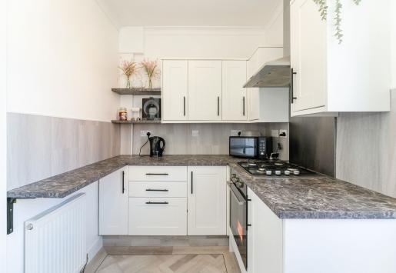
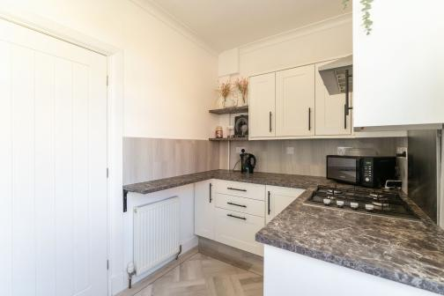
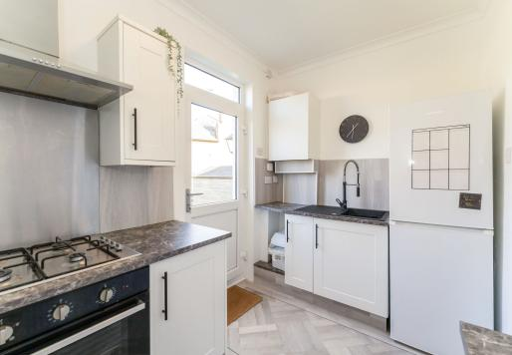
From the living room, you enter the adjoining well-proportioned modern kitchen. With direct garden access, it is a thoughtfully designed space with white shaker-style cabinets complemented by black marble-effect worktops and parquet flooring, along with a gas hob, oven, and extractor hood. On the other side of the hallway lie two spacious double bedrooms both offering built-in storage and an appealing neutral décor.

Slide 4
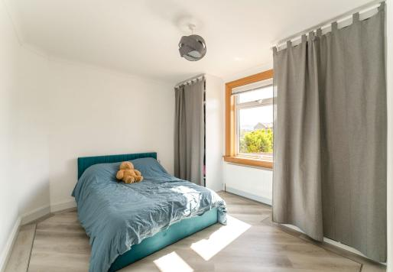
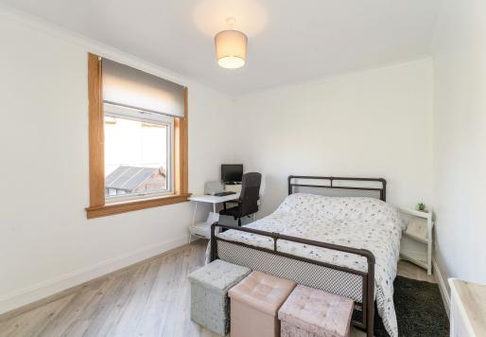
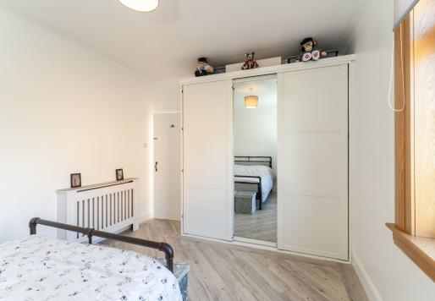
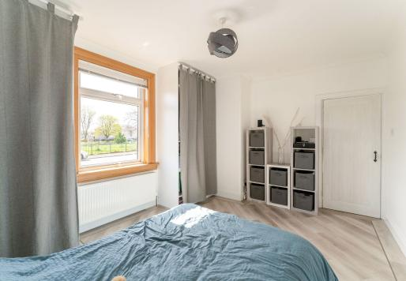

Slide 5
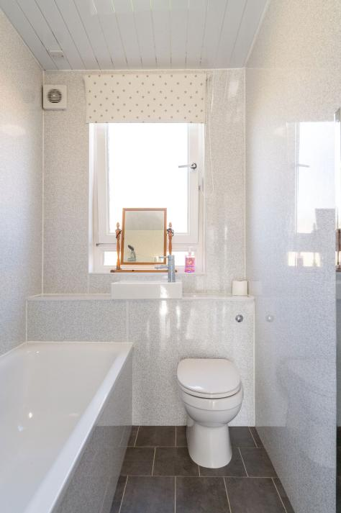
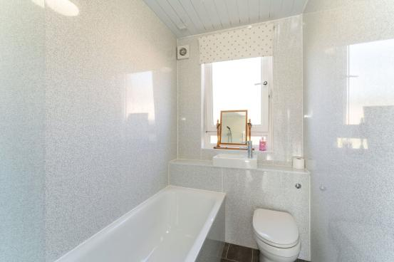
The white three-piece family bathroom houses a hidden cistern WC, washbasin, and bath set against a sleek interior.

Slide 6
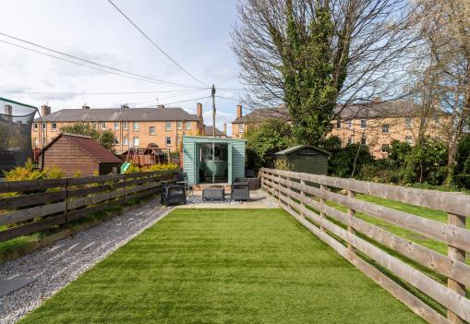
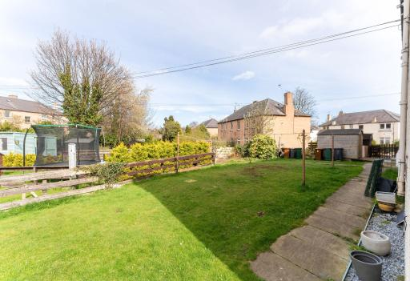
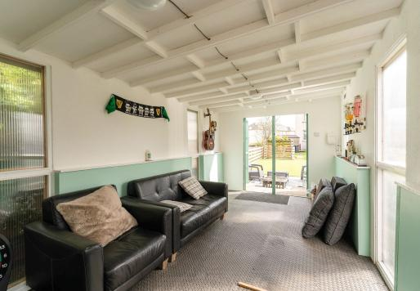
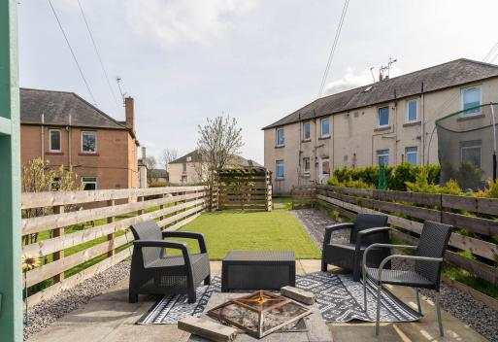
Externally the house enjoys a generous shared rear garden and its own beautifully presented private garden with a patio area, lawn, and spacious garden room complete with power, ideal for a tranquil escape or for entertaining.

Slide 7
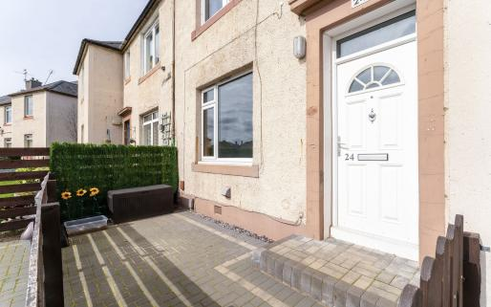
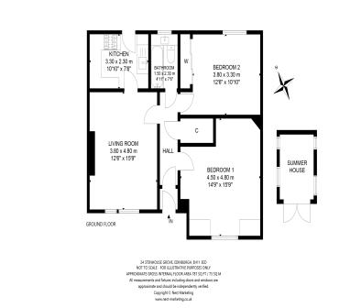
Ideally situated between Saughton and Gorgie, Stenhouse Grove is a popular residential location. The property enjoys proximity to Corstorphine Hill and the picturesque Saughton Public Park with playing fields, a play area, and a skateboard park, spanning 34 acres it also features a lovely rose garden. Murrayfield Stadium, Edinburgh Zoo, and a variety of golf courses including Carrick Knowe and Kingsknowe are all within easy reach. A state-of-the-art gym can be found on nearby Westfield Road. Bustling restaurants, cafés, and bars can be found at Gorgie and Dalry including Mia’s Italian Kitchen and Locanda de Gusti. Local shopping amenities are in abundance including a Tesco Express, Sainsbury’s supermarket, and an Aldi, and the nearby Gyle Shopping Centre houses a Morrisons and Marks and Spencer. There is well-regarded local primary and secondary schooling. The area benefits from excellent transport links including the nearby Saughton Tram Link offering quick access to St Andrew Square and Edinburgh International Airport. The West Approach Road takes you swiftly into the city centre and there is a reliable bus service.
Gas central heating and double glazing are fitted throughout to ensure a warm and comfortable home all year round. The property is near Saughton Tram Link, Saughton Public Park, and Carrick Knowe Golf Club
Get in touch
Video Tour
0131 644 6060
sales@monarch-legal.co.uk
monarch-legal.co.uk
Misrepresentations
The property is sold with all faults and defects, whether of condition or otherwise and neither the seller nor the selling agent, are responsible for such faults and defects, nor for any statement contained in the particulars of the property prepared by the said agent. The Purchaser(s) shall be deemed to acknowledge that he has not entered into contract in reliance on the said statements, that he has satisfied himself as to the content of each of the said statements by inspection or otherwise and that no warranty or representation has been made by the seller or the said agents in relation to or in connection with the property. Any error, omission or mis-statement in any of the said statements shall not entitle the purchaser(s) to rescind or to be discharged from this contract, nor entitle either party to compensation or damages nor in any circumstances to give either party any cause for action.

